Slide 1
Cloud Strategy Recommendation for Capital Alliance Investment Bank
18th July 2023

Slide 2
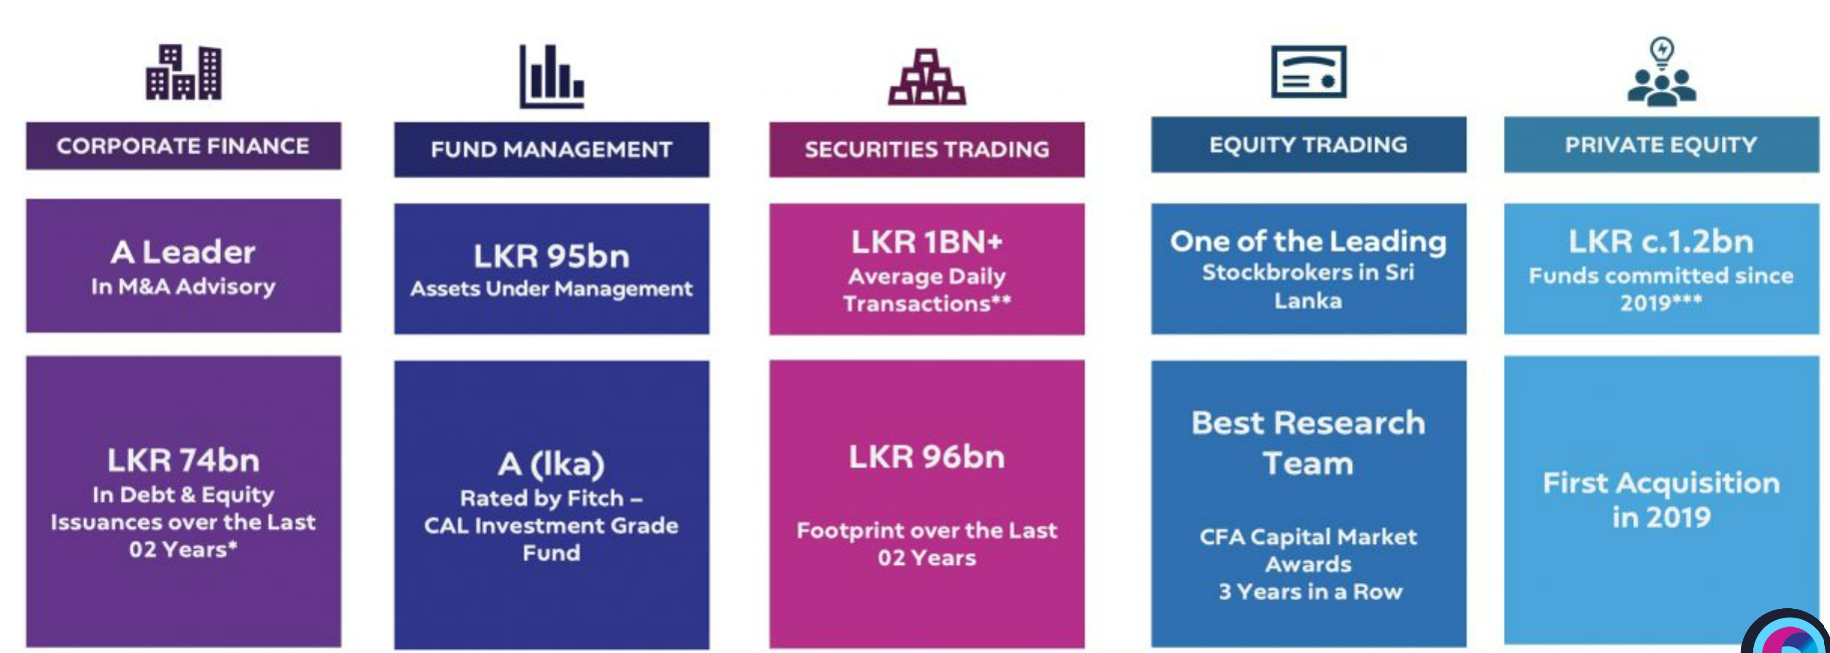
CAL – A Prominent Investment Bank from Sri Lanka
Page 01

Slide 3
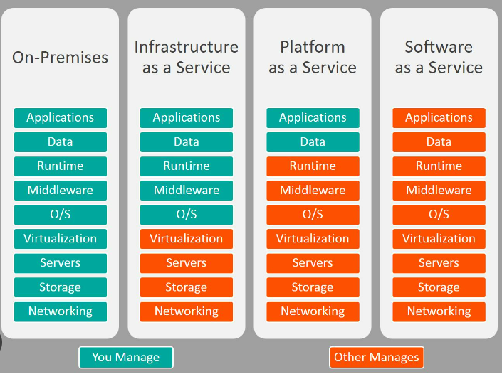
IT setup on core business – Adopt IaaS from the current SaaS model
Customization and Control - Greater flexibility and control over configuring virtual servers, storage, and networking resources is required due to a diverse client base exceeding 8,000 ranging from institutional clients to family offices.
Scalability and Resources - Equity trading and stock markets are busy during Mondays and after holidays. Similarly, the auction days generate increased server requirements for trading government securities without any delays.
Development and Testing - CAL’s utilization of Auto trading software, including Expert Advisors, demands rigorous back-testing for trading strategies.
IT Expert and Control - CAL has significantly bolstered its staffing, experiencing a 200% increase over the past two years. With a skilled IT team in place, the adoption of IaaS becomes advantageous as it offers enhanced control over infrastructure management and maintenance.
Data Security - In IaaS, the user has more control and responsibility over the security of their data and applications.
Page 02

Slide 4
CRM – Recommendation based on IaaS and PaaS
By adopting an advanced CRM management system, CAL can streamline its client communication processes, provide timely and accurate information, and enhance overall client satisfaction. The following options can be recommended for CAL as CRM solutions,
AWS - Amazon Elastic Compute Cloud (EC2), Amazon Simple Storage Service (S3), and Amazon Virtual Private Cloud (VPC).
These provide scalability, high availability, and robust security features.
Azure - Azure Virtual Machines, Azure Storage, and Azure Virtual Network.
Leveraging the platform's scalability, global presence, and integration with Microsoft products like Dynamics 365 CRM.
As a less aggressive option, Salesforce itself offers a platform-as-a-service (PaaS) option called App Cloud
This provides the infrastructure needed to run Salesforce CRM applications. It allows the company to leverage the scalability, security, and integration capabilities of the Salesforce platform for hosting the CRM system.
Page 03

Slide 5
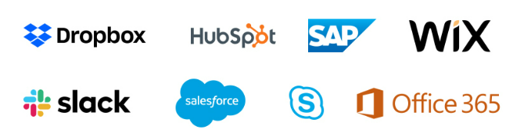
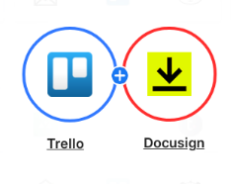
Communications and Meetings – SaaS itself is a good to go option
Currently, CAL is using Microsoft 365. Implementing a cloud-based communication solution enables seamless and efficient internal and external communication for the business. Hence, its recommended to retain the same since there are high costs and complexities associated with maintaining and managing an Exchange server
Page 04

